Slide 1
Statecharts: A Visual Formalism for Complex Systems
Jeff Peng
jpeng@u.arizona.edu
Model-based Design Lab

Slide 2
Agenda
Introduction: Statechart Diagrams
Statemate Semantics of Statechart
Statemate Working Environment
Statemate Tutorial
Further Readings

Slide 3
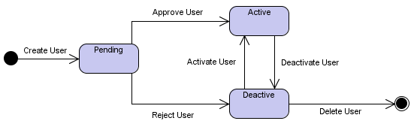
Introduction:
Statechart Diagrams
Design of complex reactive systems
Statechart in a nutshell
Basic notation:
  State
  Transition
  Initial State
  Final State
Notes:
The literature on software and systems engineering is almost unanimous in
recognizing the existence of a major problem in the specification and design of large
and complex reactive systems. A reactive system, in contrast with a
transfohnational system, is characterized by being, to a large extent, event-driven,
continuously having to react to external and internal stimuli. Examples include
telephones, automobiles, communication networks, computer operating systems,
missile and avionics systems, and the man-machine interface of many kinds of
ordinary software. The problem is rooted in the difficulty of describing reactive
behavior in ways that are clear and realistic, and at the same time formal and
rigorous, sufficiently so to be amenable to detailed computerized simulation. The
behavior of a reactive system is really the set of allowed sequences of input and
output events, conditions, and actions, perhaps with some additional information
such as timing constraints.
In a nutshell, statechart is simply a network of states and events.
Statechart diagrams, also referred to as State diagrams, are used to document the various modes ("state") that a class can go through, and the events that cause a state transition. For example, your television can be in the Off state, and when the power button is pressed, the television goes into the On state. Pressing the power button yet again causes a state transition from the On state to the Off state. In comparison the other behavioral diagrams which model the interaction between multiple classes, State diagrams typically model the transitions within a single class.

Slide 4

Statechart Diagrams: Notation
State: a mode of the entity.
A rectangle with rounded corners, and the state name
Notes:
The State notation marks a mode of the entity, and is indicated using a rectangle with rounded corners, and the state name written inside.

Slide 5

Statechart Diagrams: Notation
Transition: changing of the object State
An arrow, with the Event Name
Notes:
A Transition marks the changing of the object State, caused by an event. The notation for a Transition is an arrow, with the Event Name written above, below, or alongside the arrow.
Transitions
If event E occurs in state S and condition C holds then make the transition to state T.
Actions to be carried out when event E occurs in state S are normally put into an event-action table rather than part of the diagram. The actions could be lengthy and detailed.

Slide 6
Statechart Diagrams: Notation
Initial State: state of an object before any transitions
Marked using a solid circle
Only one initial state is allowed on a diagram

Slide 7
Statechart Diagrams: Notation
Final State: destruction of the object
A solid circle with a surrounding circle

Slide 8
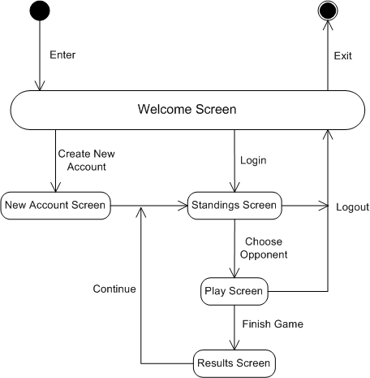
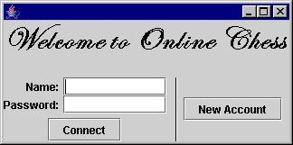
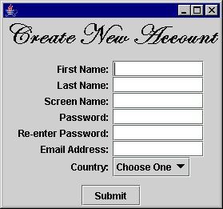
Example: Online Chess

Slide 9
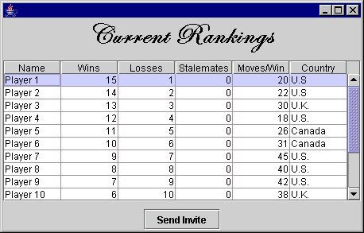
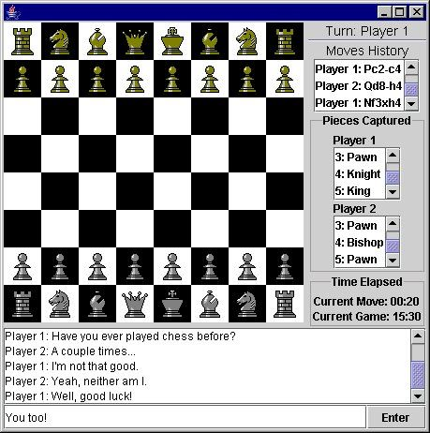
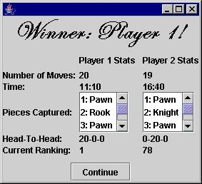

Slide 10
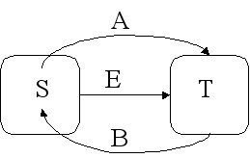
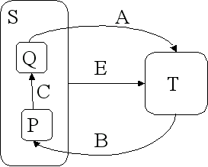
Statechart Diagrams: Hierarchy
Hierarchical Statecharts (FSM are flat)
Arrows go inside node S
Sub states inside state S
Notes:
FSM are flat. They provide no facility to represent hierarchies.
Details sometimes can to be hidden to portray higher level abstraction.
Because the arrows go inside node S, events A and B indicate that there is more detail in state S.
When in state S it is also in either state P or Q.
When in state S, move from P to Q on event C
When in state T move to state S and within S to P on event B.
Regardless of states P or Q, on event E, move to T
Move to T from Q and S on event A

Slide 11
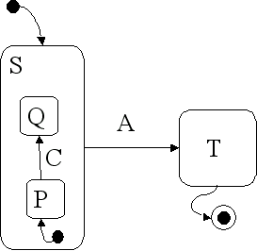
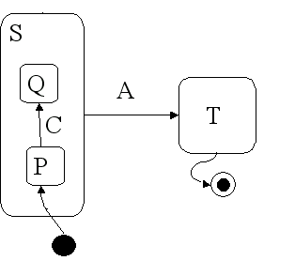
Statechart Diagrams: Default State
Notes:
A nested statechart should have a start point indicated and a stop state if it's not obvious.

Slide 12
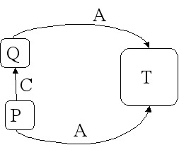
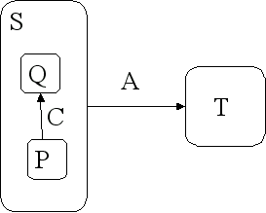
Statechart Diagrams: Clustering
Clustering: form of hierarchy
Advantage
Notes:
The advantage is the reduction in the number of arrows. Better representation of hierarchy
Likely states P and Q are abstractly different from T.

Slide 13
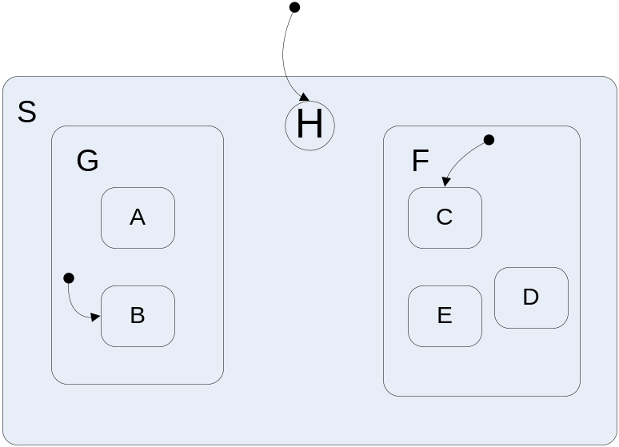
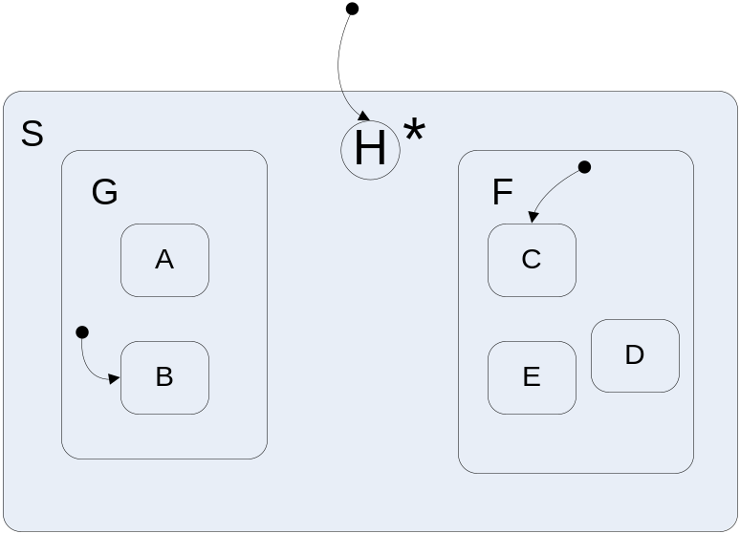
Statechart Diagrams:
History Mechanism
Resume from last state inside nested chart
Initialization of history variable.
Notes:
When entering a state that has a nested statechart, you may want to resume where you left off when you left the enclosing state. The encircled H as the entry point as below means to start in the state within that was exited.
Each level can have its own history mechanism. Each history variable would be initialized to the start state of the level.
It should be noted that an H generally means that history is applied only on the
level in which it appears, so that in Fig. 11 (a) history chooses only between G and
F; that is, the system enters B if it was in A or B when it most recently left K, and
C if it was in C, D or E on that last visit. The choice of B and C here is by the
default arrows. History can be made to apply all the way down to the lowest level
of states by attaching an asterisk to the H-entry.

Slide 14
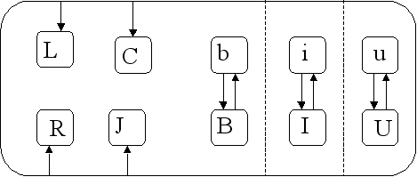
Statechart Diagrams: Concurrency
Manage multiple states simultaneously
Example: style types bold, italics and underline.
Notes:
Concurrency refers to the ability to manage more than one state simultaneously.
Consider the 3 style types -- bold, italics and underline. These styles can be used in any combination. Bold is on or off, italics is on or off, underline is on or off. The total number of states is 2*2*2 = 8 and the number of transitions is nearly as bad

Slide 15
Statechart Diagrams
Delays:
  delayTime < in the state. E.g., 10 sec <
Timeouts
  < timeoutAmt in the state, e.g, < 5 min
Notes:
Delays are indicated by including a notation of delayTime < in the state. E.g., 10 sec <
Delays cause the state to hold against any action or event to occur until the delaytime has expired.
Timeouts are indicate by a similar notation < timeoutAmt in the state, e.g, < 5 min and then have an extra event arc labeled "timeout" exiting the state. That is, time out is an event.

Slide 16
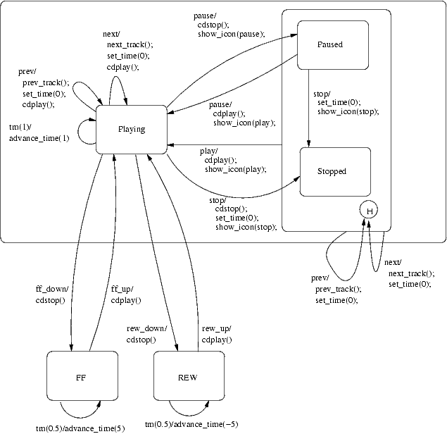
Example: CD Player
Notes:
This is a statechart for a typical CD player. Each transition is labeled with the event that triggers it and the operation(s) that are to be invoked when it is fired.
The CD player interface is composed of 7 buttons (play, pause, stop, next, prev, ff, rew) and a display. The display shows the current track, the time elapsed on that track and a play/pause/stop icon.
Events
The events are generated by button interactions.
play: play button is pressed and released
pause: pause button is pressed and released
stop: stop button is pressed and released
prev: prev button is pressed and released
next: next button is pressed and released
ff_down: ff button is pressed
ff_up: ff button is released
rew_down: rew button is pressed
rew_up: rew button is released
Operations
set_time(t)
Sets the current time to t and adjusts the display accordingly.
advance_time(delta_t)
Adds delta_t seconds to the current time and adjusts the display accordingly. delta_t can be negative in which case the current time is decremented. If the current time becomes negative (resp. larger than the current track length), then prev_track() (resp. next_track()) is called and the time is set to the track length (resp. zero).
prev_track()
The current track is decremented by 1 unless the current track is already the first one on the CD. The display is adjusted accordingly.
next_track()
The current track is incremented by 1 unless the current track is the last on the CD. The display is adjusted accordingly.
cdplay()
The CD driver is instructed to start playback at the current track and the current time.
cdstop()
The CD driver is instructed to stop playback.
show_icon(play|pause|stop)
Displays the corresponding icon.

Slide 17
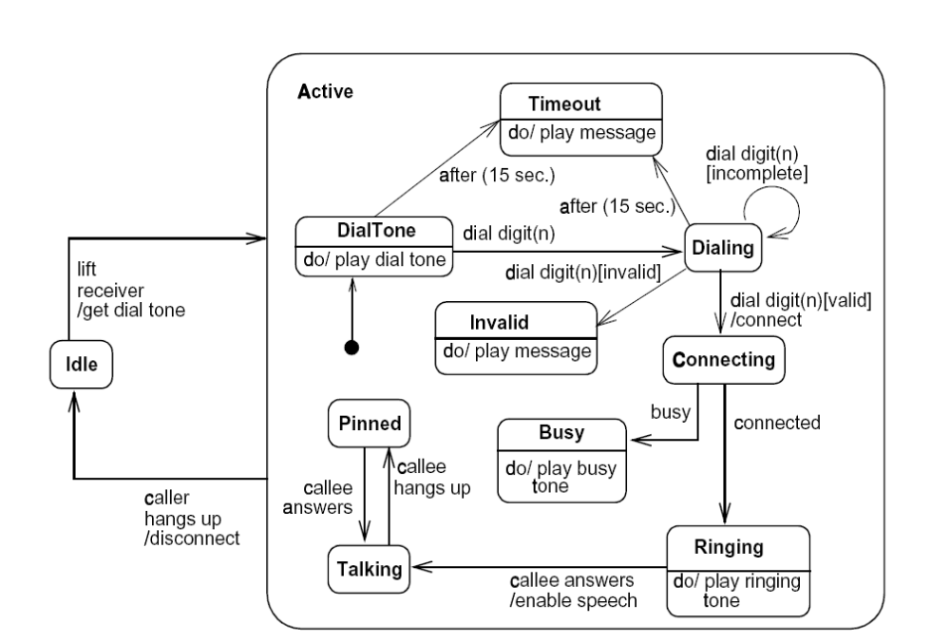
Example: Telephone

Slide 18
Statemate Semantics of Statechart
First executable semantics
Central consideration: clarity, simplicity
Designed for real-life complex systems, support different styles of modeling.
Fast prototyping
Generates useful hardware and software
Notes:
We describe the semantics of statecharts as implemented in the STATEMATE system. This
was the first executable semantics defined for the language and has been in use for almost a
decade. In terms of the controversy around whether changes made in a given step should take
effect in the current step or in the next one, this semantics adopts the latter approach.
Subtle issues arise when one tries to define a semantics for the language,
and there is no consensus on the “right” way to go about the task. Since
statecharts were intended from the start to be used by real engineers in
specifying real systems, one of the central considerations in deciding upon a
useful semantics is clarity and simplicity. A user need not see the details of
the mathematical definition, but he or she must be able to understand how
it works in a relatively intuitive way.
This article describes the semantics of the language of statecharts as
implemented in the STATEMATE1 system [Harel et al. 1990; Harel and
Politi 1996]. The initial version of this semantics was developed by a team
In 1980’s. With the added experience of the users of the system it
has since been extended and modified.
Being an unofficial language, statecharts clearly have no official semantics,
and researchers are free to propose semantics as they see fit. However,
the only implemented and working semantics for statecharts has for many
years been the one described here,
The main consideration behind the definition and selection of the semantics
described here is that STATEMATE is a commercial tool, designed for
the specification and design of real-life complex systems, coming from a
variety of disciplines. As such, the semantics has to be rich enough to
support different styles of modeling, yet it should be simple and intuitive.
It must also be technically straightforward enough to enable fast simulation
of models and to generate useful hardware and software code out of
these models. It is noteworthy that VHDL, the IEEE standard language for
the description of hardware, which evolved around the time the semantics
of statecharts as described here was defined, adopted the same approach,
i.e., that changes carried out in a given step (or “delta” in the VHDL
nomenclature) can be sensed only in the following one.

Slide 19
Statemate Working Environment
Development of complex reactive systems
  Specification
  Analysis
  Design
  Documentation
Heavy graphical oriented
Captures structure, functionality, and behavior
Notes:
Statemate is a set of tools, with a heavy graphical orientation, intended for the specification, analysis, design and documentation of large and complex reactive systems. It allows a user to prepare, analyze, and debug diagrammatic, yet precise, descriptions of the system under development, from three interrelated point of view, capturing structure, functionality, and behavior.

Slide 20
Structural Point of View
Decomposition of SUD
Identifies information flow
Notes:
In the structural view, the user provides a hierarchical decomposition of the system under development into its physical components, called modules here, and identifies the information that flows between them, that is the chunks of data and control signals that flow through whatever physical links exist between the modules.

Slide 21
Conceptual Model
Consists of functional view and behavioral view
Functional view:
  Functional decomposition of SUD
  Does not specify dynamics
Behavioral view:
  Specifies control activities
  Tests conditions and variables
Notes:
The conceptual model of the SUD consists of functional view and behavioral view.
In the functional view we do not specify dynamics; we do not say when and why the activities are activated, whether or not they terminate on their own, and whether they can be carried out in parallel, such and such.
It is the behavioral view, our third, that is used to specify the control activities. It is responsible for specifying whe, how and why things happen as the system under development reacts to events over time.

Slide 22
Statemate languates
Module-charts ←→ structural view
Activity-chart ←→ functional view
Statecharts ←→ behavioral view
Notes:
Statemate provides graphical diagrammatical languages, module-charts, activity-charts, and state-charts respectively.
All three languages are based on a common set of simple graphical conventions and come complete with graphics editors that check for syntactic validity.

Slide 23
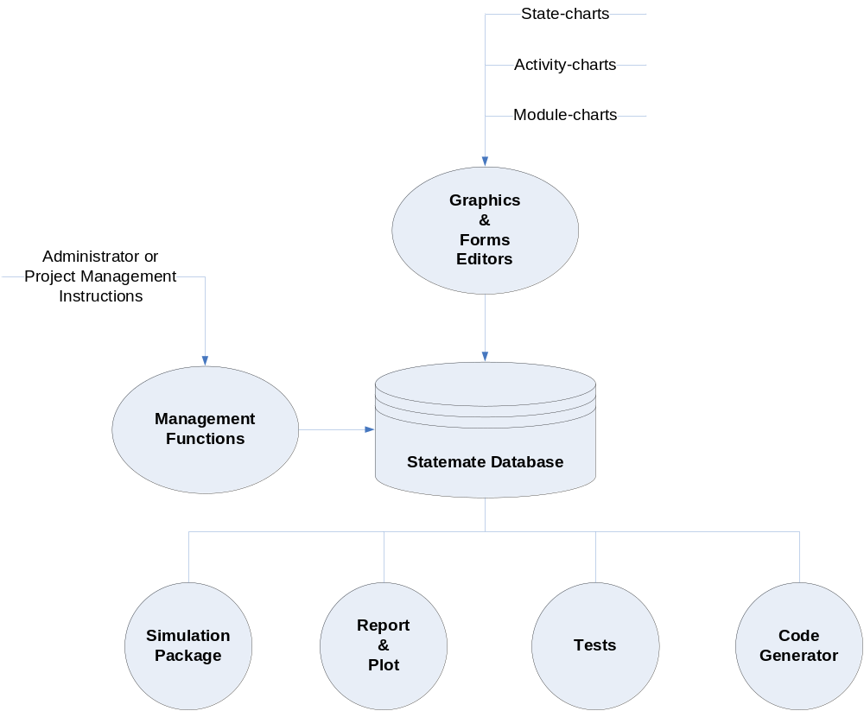
Statemate Structure

Slide 24
Statemate Tutorial:
Design Flow of Digital Clock
Step 1: requirement statement
  Display the current time of day
    In hours and minutes
    Minute value increment every 60 seconds
    Hour value increment every 60 minutes
  Set the time of day
    Display the set time in hours and in minutes
    Increment the minutes
    Increment the hours
  Switch between modes
  Power present: in operation mode
  Power removed: blank display
  Power returns: set time mode
Notes:
The main purpose of the clock shall be to display the current time of day, but it shall also have a mode that will allow the user to set the time of day. The user will be able to select which mode the clock will be operating in via a selection switch.
The clock will be in operation mode whenever power is present. If power is removed, the clock shall have a blank display until power returns. When power returns, the clock shall enter the set time mode.
In the set time mode, the clock will display the set time in hours and in minutes. The user will be able to increment the minutes by pressing the set minute button and will be able to increment the hours by pressing the set hours button.
In the current time mode, the clock will display the current time of day in hours and minutes. The minute value will increment every 60 seconds and the hour value will increment every 60 minutes.

Slide 25
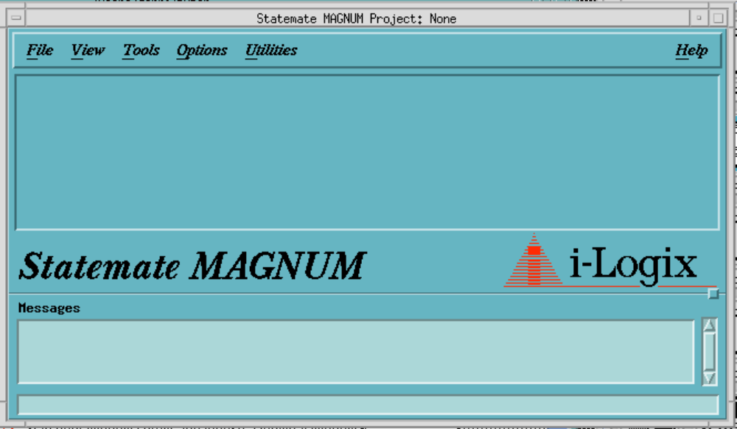
Step 2: Getting Started
Start Statemate
Create a project
Open the project

Slide 26
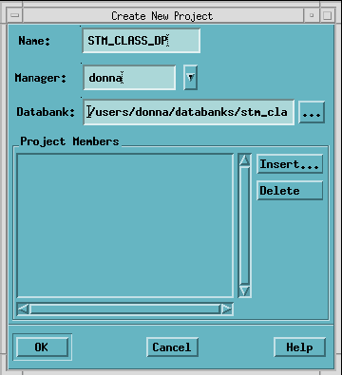
Step 2.2 Creating Project
Name: STM_CLASS_DP
Manager: your login
Databank: path to
the databank directory

Slide 27
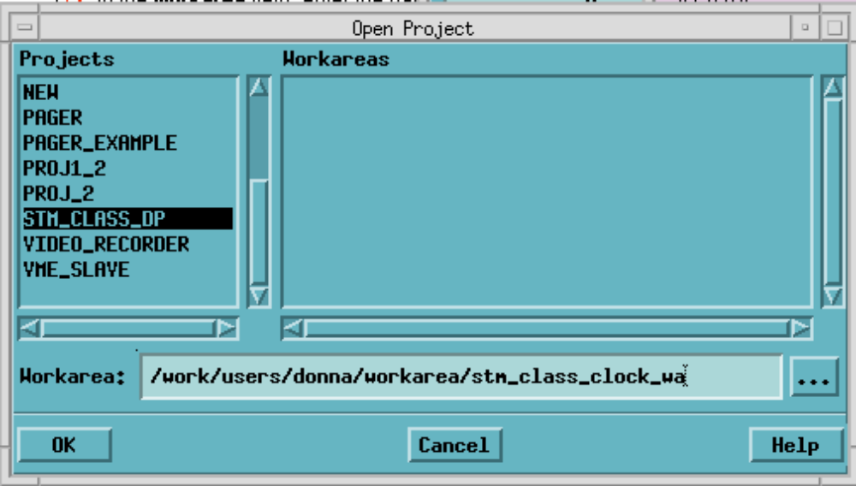
Step 2.3 Opening the Project

Slide 28
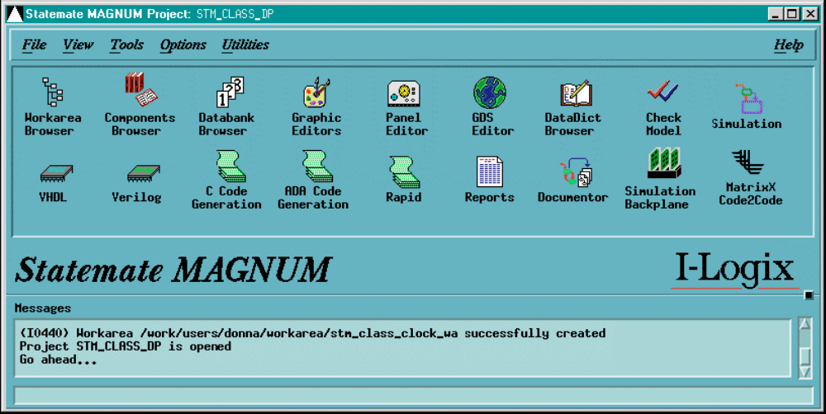
Statemate Main Window

Slide 29
Step 3: Creating the Activity-Chart
Internal Activities
Control activities
External activities
Data flows
Notes:
In this chapter, you create an Activity-chart.
In class, you learned that Activity-charts represent the functional
view of a system. You also learned that they consisted of the
following elements:
• Activities, which represent the functions in the system.
• Control activities, which represent the link to Statecharts.
These Statecharts can control other activities or represent
the activities behavior.
• External activities, which represent elements outside of
the system (or current view) that the activities interface with.
• Data flows, which represent the exchange of data between
activities.
While creating this Activity-chart, you will functionally decompose
the clock into activities and you will show the external
environment of the clock using external activities. You will also
use data flows to represent the exchange of information between
activities.

Slide 30
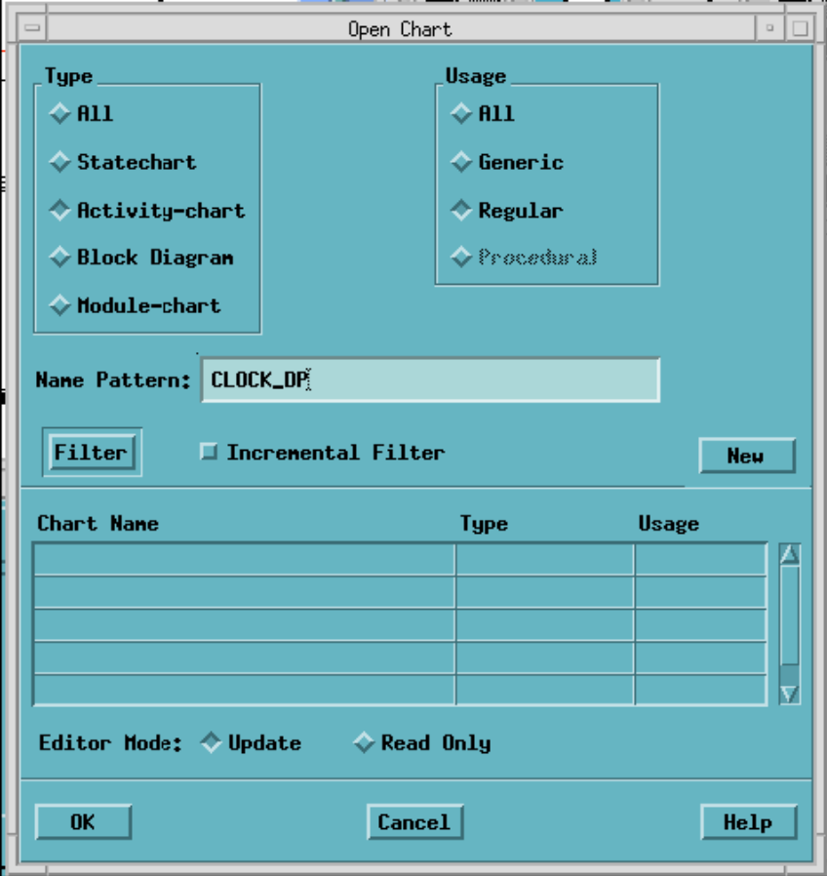

Activity-chart Graphics Editor
Select the Graphic Editors icon from the Statemate Main window.
Fill in the Open Chart form as follows:
  Type: Activity-chart
  Usage: Regular
  Name Pattern: CLOCK_your_initials
Select the New button.

Slide 31

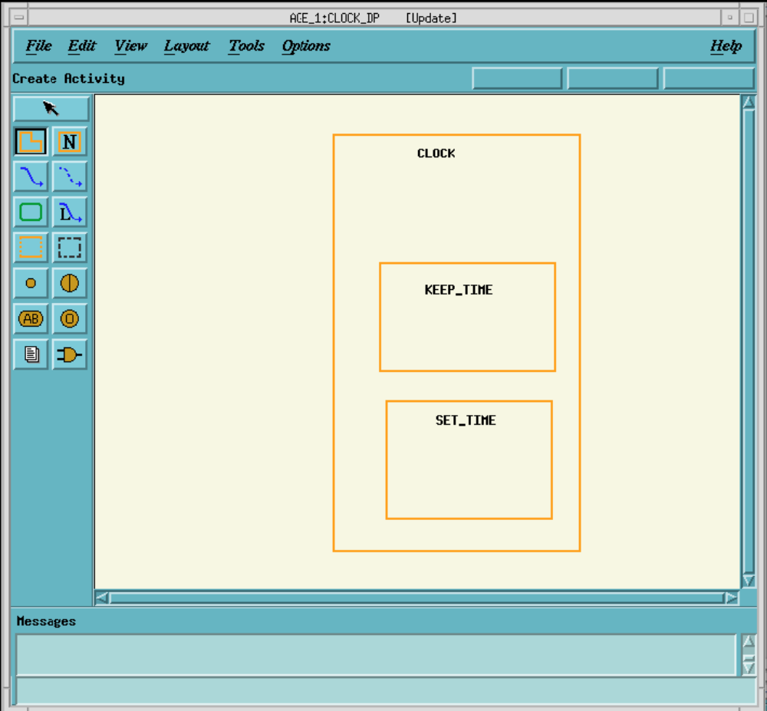
Step 3.1: Creating Internal Activities

Slide 32

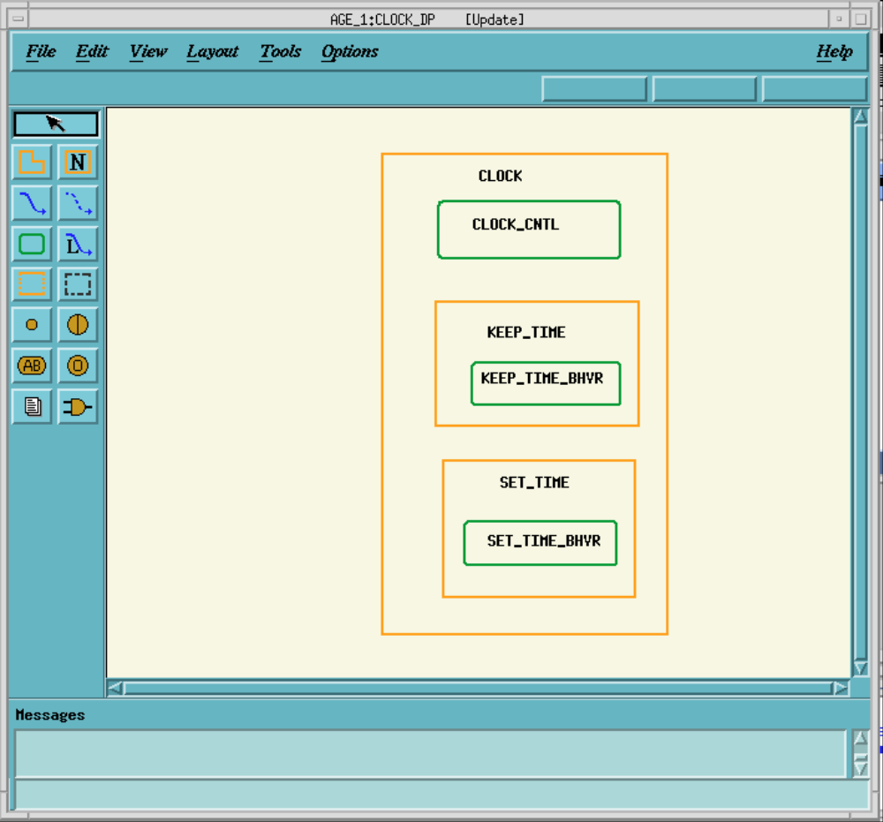
Step 3.2: Creating Control Activities

Slide 33

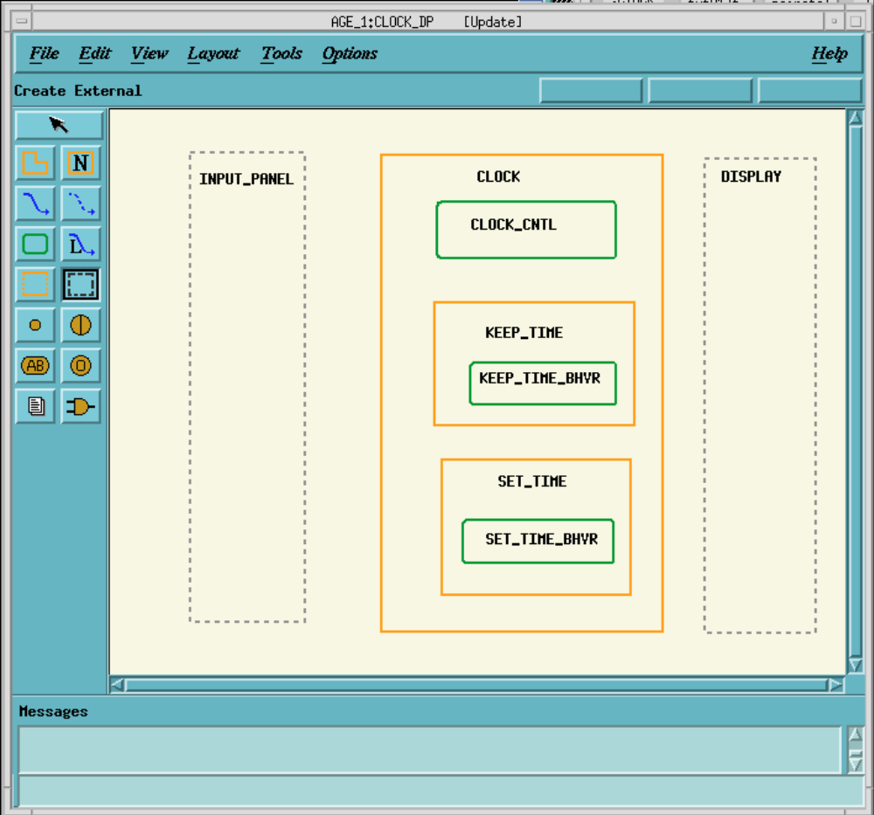
Step 3.3: Creating External Activities

Slide 34
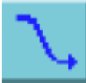
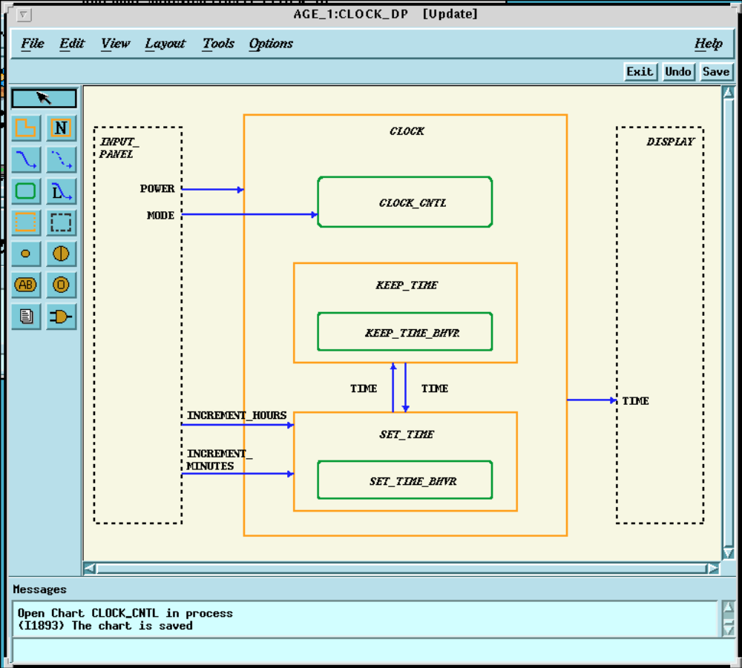
Step 3.4: Drawing Flows

Slide 35
Step 4: Creating Statecharts
Select the Graphic Editors icon from the Statemate Main window.
Fill in the Open Chart form as follows:
  Type:Statechart
  Usage:Regular
  Name Pattern:CLOCK_CNTL
Select the New button.

Slide 36

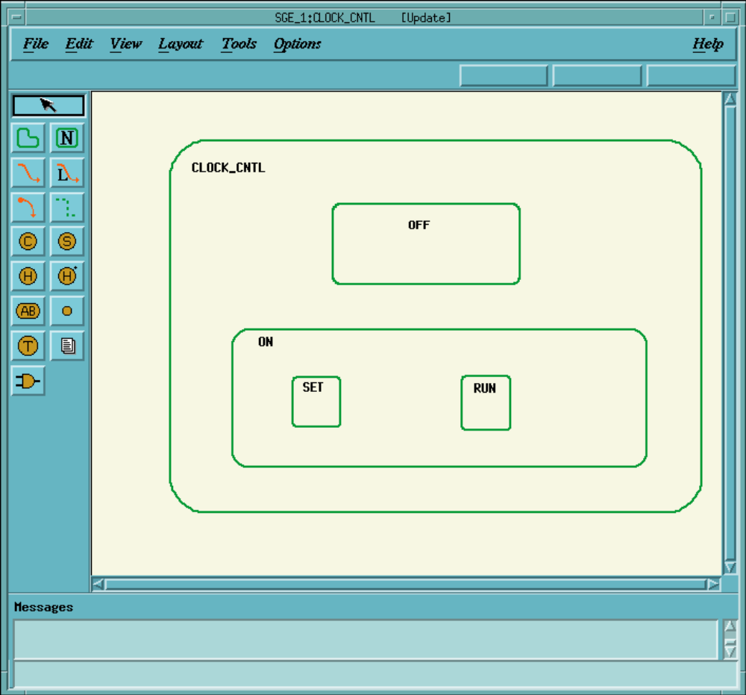
Step 4.1: Drawing States

Slide 37
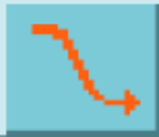
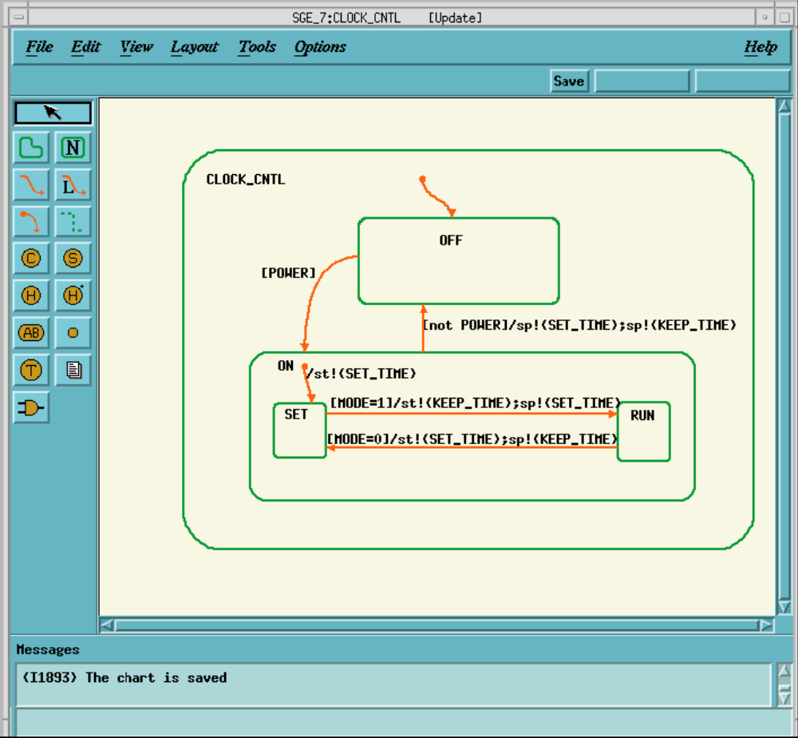
Step 4.2: Drawing Transitions

Slide 38

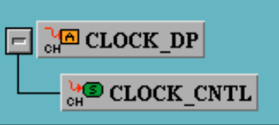
Step 4.3: Associating the Control Activity with the Statechart
In the Workarea Browser, locate the CLOCK_your-initials
Activity-chart. Double click on this chart’s icon with the left
mouse button to open the chart.
Locate the CLOCK_CNTL control activity.
Double click on the CLOCK_CNTL control activity name.
causes the name to be highlighted in black with a cursor
appearing.
Click the left mouse button at the beginning of the name and then move the cursor to the left of the name.
Type the @ symbol.

Slide 39
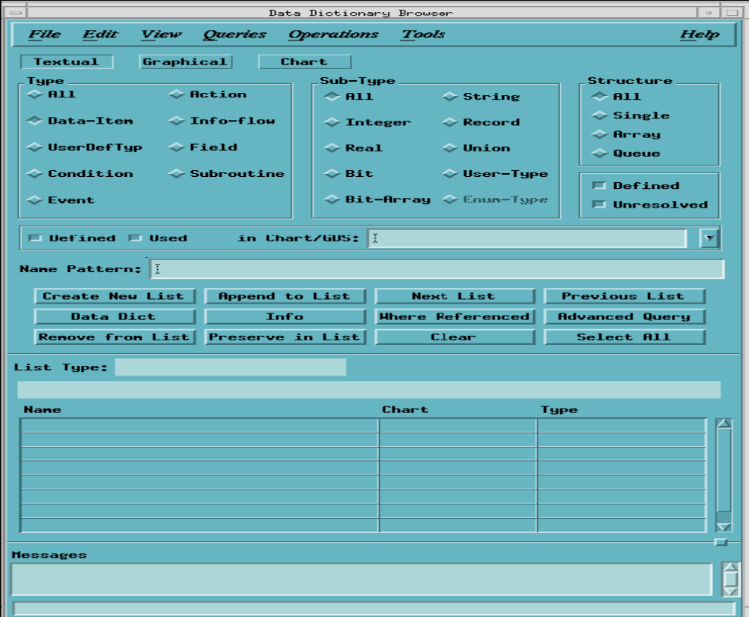
Step 5: Defining the Textual Elements

Slide 40
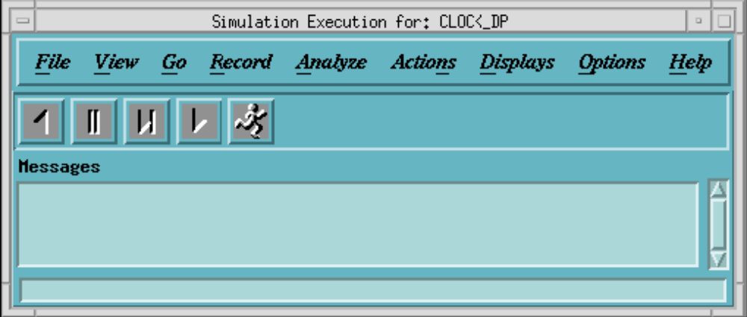
Step 6: Simulating the Model
If the CLOCK_your-initials Activity-chart is not open, open it using the Workarea Browser.
Select the CLOCK activity.
Select Tools>Simulation to open the simulation Execution main window.

Slide 41
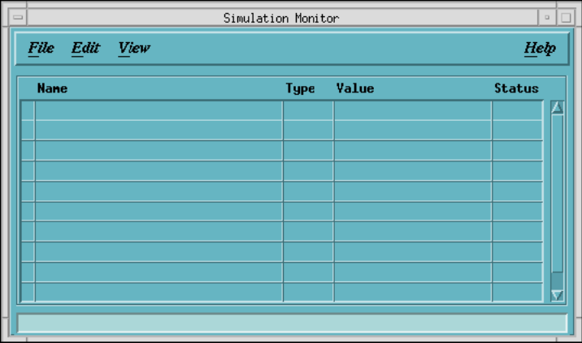
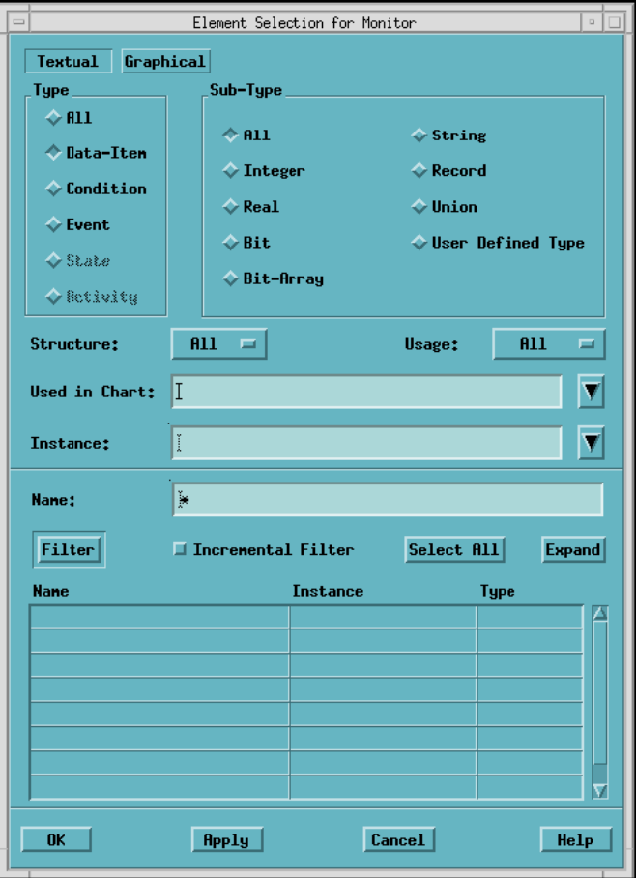
Step 6.1: Setting Up a Monitor WIndow
Select Displays>Monitors to open an empty Simulation
Monitor window.
Select Edit>Add ‘to open the Element Selection for
Monitor window.

Slide 42

Step 6.2: Stepping Through the Simulation
Organize viewing area
Simulate the model
Go Step from the Simulation Execution window

Slide 43
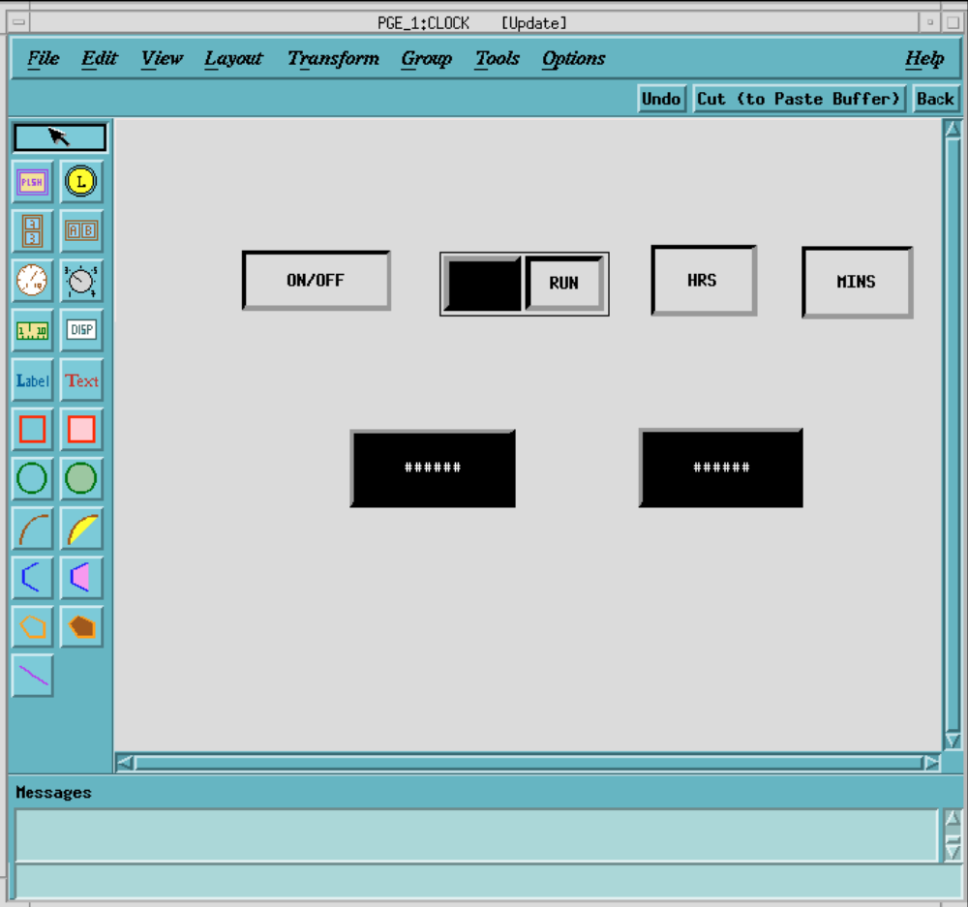
Step 7: Panel Creation and Simulation

Slide 44
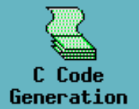
Step 8: Code Generation and Execution
Create a code generation profile
Use the profile to generate code
Run the code

Slide 45
Further Readings
Harel, D., The STATEMATE semantics of statecharts, ACM Transactions on Software Engineering and Methodology (TOSEM) archive, October 1996, Volume 5, Issue 4, Pages: 293 – 333
Harel, D., STATEMATE: a working environment for the development of complexreactive systems, IEEE Transactions on Software Engineering, Apr 1990 Volume: 16, Issue: 4, Pages: 403-414
Harel, D., Statecharts: A visual formalism for complex systems, Science of Computer Programming, 1987
StateMate Magnum Tutorial, I Logix

